Slide 1
Java Course Introduction
Università di Modena e Reggio Emilia
Prof. Nicola Bicocchi (nicola.bicocchi@unimore.it)

Slide 2
What?
Object-oriented programming (OOP) is a programming paradigm based on the concept of class objects, which can contain both data and code
Data in the form of variables (known as attributes)
Code in the form of functions (known as methods)
Java and Python are among the most prominent languages in the field

Slide 3
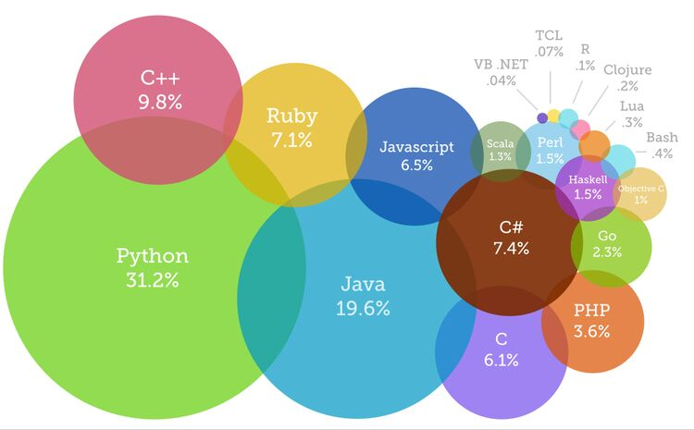
Why?
OOP followed Procedural Programming due to serious limitations affecting large-scale projects
OOP is the de facto standard for industrial software
Building modern applications almost always requires OOP languages such as Java, Python, C#, C++

Slide 4
How?
https://github.com/nbicocchi

Slide 5
When?
Thursday 9.15 - 10.45
Thursday 11.15 - 13.00
Friday 13 - 16 (Lab)

Slide 6
Exam?
Oral examination about OOP and the Java and Python languages (short written exercises might be used)
Discussion about the structure and engineering choices of the home project written in Java or Python (1000-5000 SLOC)

